Slide 1
Project name: Price Control Hub
Assalamualaikum

Slide 2

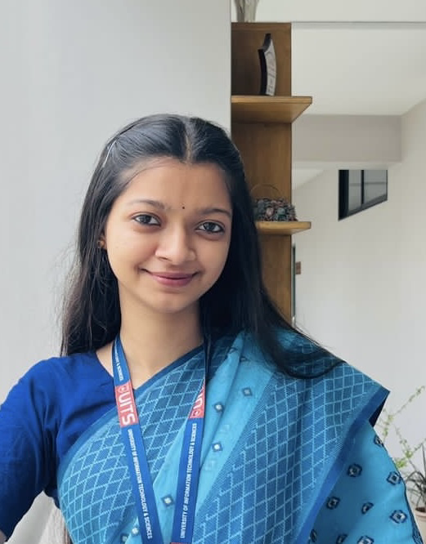


Our Team
Name : Md Shakib
Ahamed
ID :2215151130
Section:C2
Batch :51
Name : Rawnak
Tasnim Ruku
ID :2215151152
Section:C2
Batch. :51
Name : Md.Omayer
Hasan Muhit
ID :2215151135
Section:C2
Batch. :51
Name : Sayeda
Ferdoushi Islam
ID :2215151148
Section:C2
Batch. :51

Slide 3
Table of contents
INTRODUCTION
OBJECTIVES
Software Features Description
Software Requirements Specifications (SRS)
All Features
6. Software Diagram
7. Requirements
8.Comparison with Existing Software
9. Benefits
10. Uniqueness
11. References

Slide 4
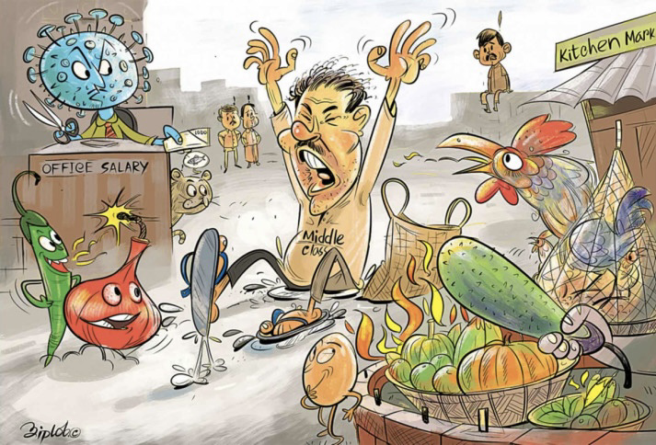
Introduction
- A comprehensive website designed to display food prices in real-time for each district in Bangladesh.
- Users can view prices, submit complaints, and check price history.
- Admins can securely log in to update prices, ensuring accurate and timely data.

Slide 5
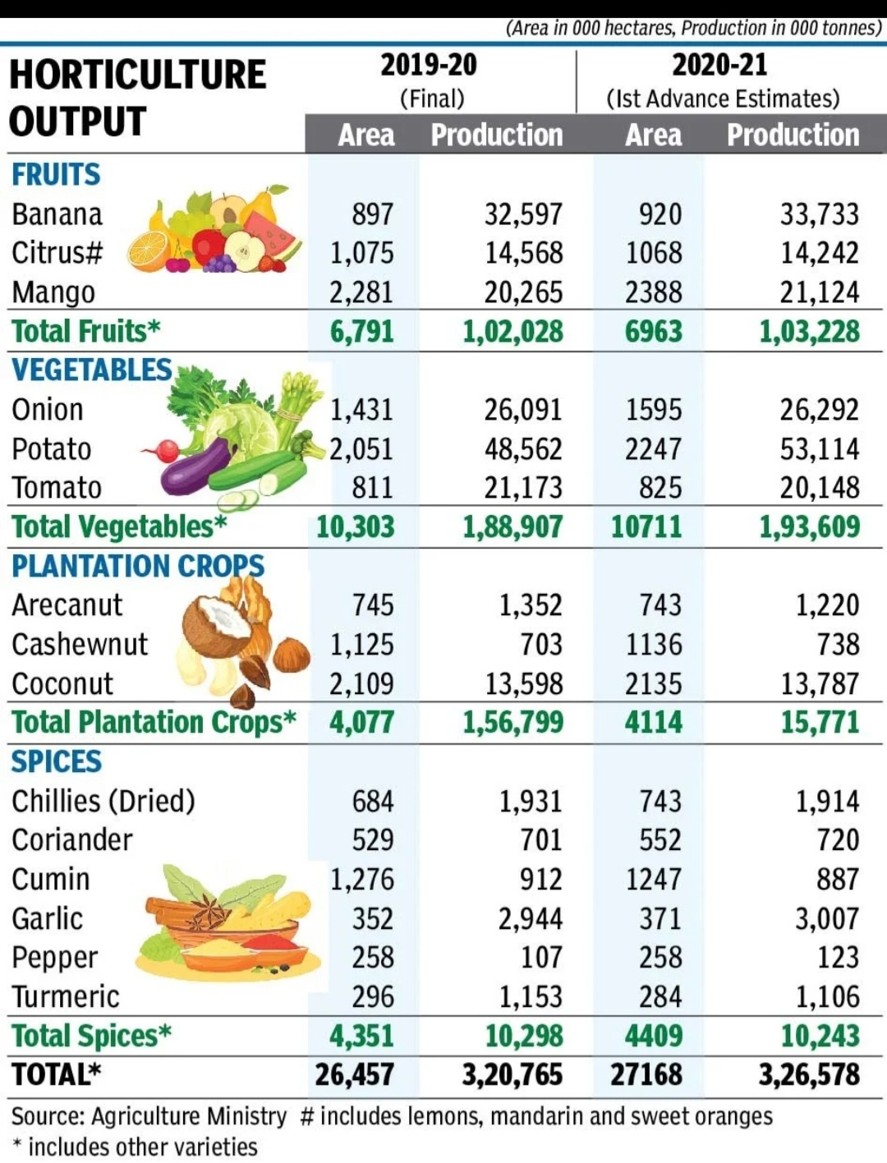
Objectives
- Provide a platform for users to check food prices across 64 districts.
- Allow price updates by admins through a secure login system.
- Enable complaints submission for specific food items by users.
- Display price trends over weekly, monthly, and yearly periods.

Slide 6
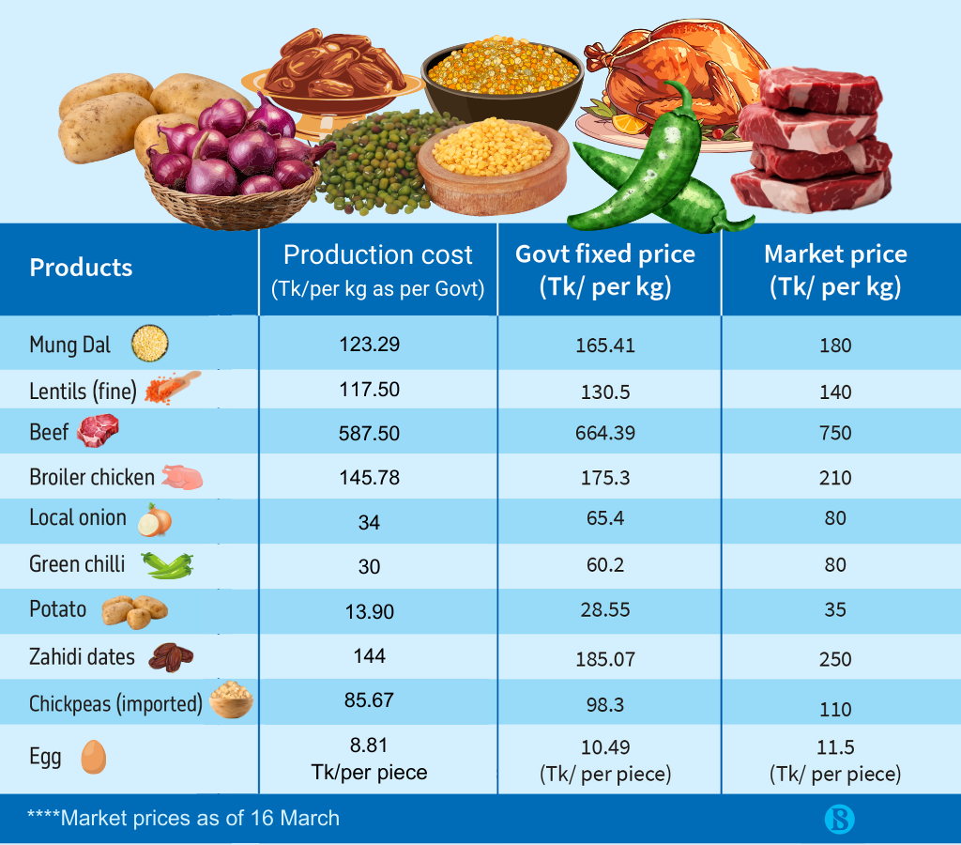
Software Features Description
- User Login: Check current food prices, file complaints, view price history.
- Admin Login: Securely update food prices for different districts.
- Price History: Display prices based on weekly, monthly, and yearly trends.
- Complaint System: Users can submit complaints with personal details and item specifics.
Concept 2

Slide 7
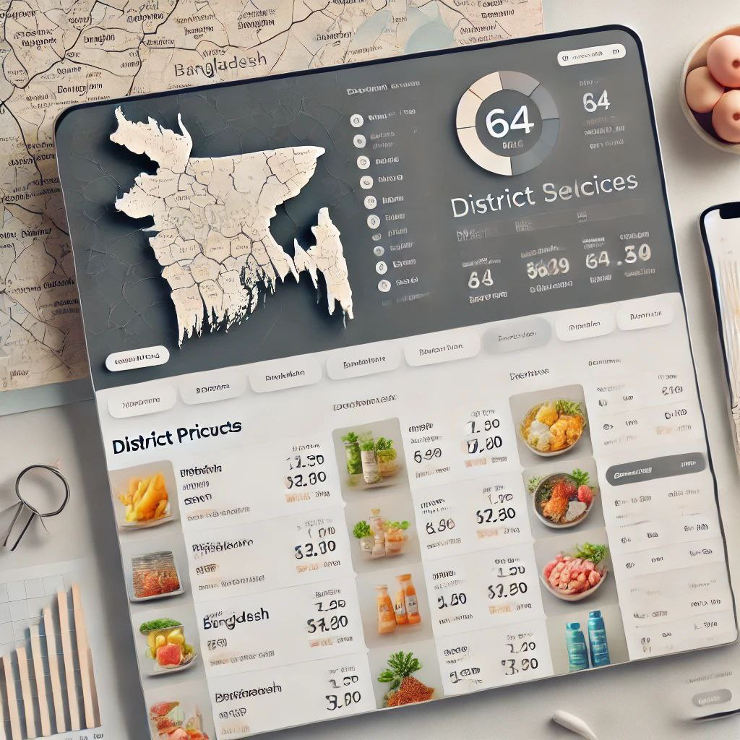
Software Requirements Specifications (SRS)
- Functional Requirements:
- Display food prices by district, update prices securely by admins.
- Complaint submission for users with detailed information on specific food items.
- Non-Functional Requirements:
- High-level security for admin logins.
- User-friendly interface and efficient system performance.

Slide 8


All Features
Food Price Display: Real-time updates for each district.
- Admin Controls: Secure access for updating price lists.
- Historical Price Data: Weekly, monthly, and yearly trends.
Complaint Filing System: Attach food items to complaints with user information.
User Profile:Users can check past complaints and price checks.

Slide 9
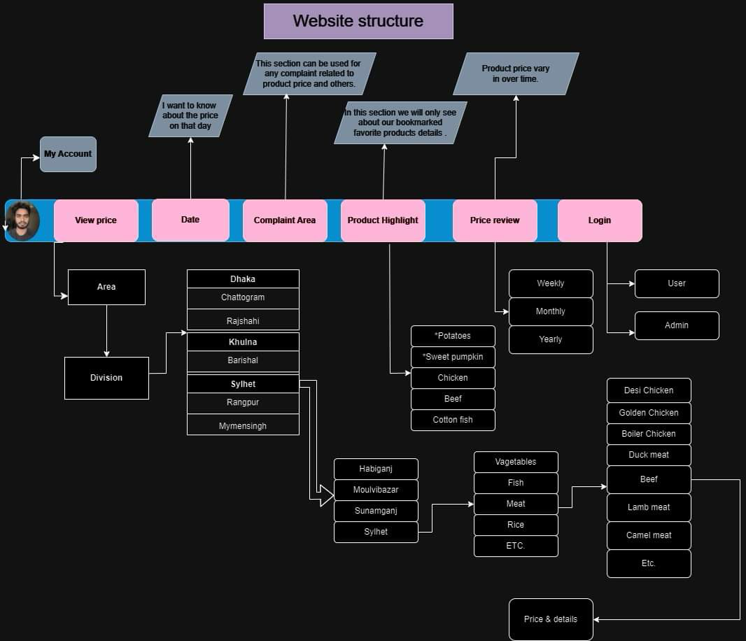
Software Diagram

Slide 10
Requirements
Frontend | Technologies: HTML5, CSS3, JavaScript(React.js)
 | Features:User-friendly interface, district selection, price filter by time period
Backend | Technologies: Django
 | Security: Multi-factor authentication for admins
Database | Type: MySQL
 | Data:Prices, districts, complaint details, admin logs

Slide 11
Comparison with Existing Software
Our website:
Existing website:
“e-government”
- Focus on general e-commerce
- Limited price – tracking options.
- District-specific food prices.
- Real-time updates by admins.
- Comprehensive complaint system integrated with food items.
- Price history displayed clearly for users.

Slide 12
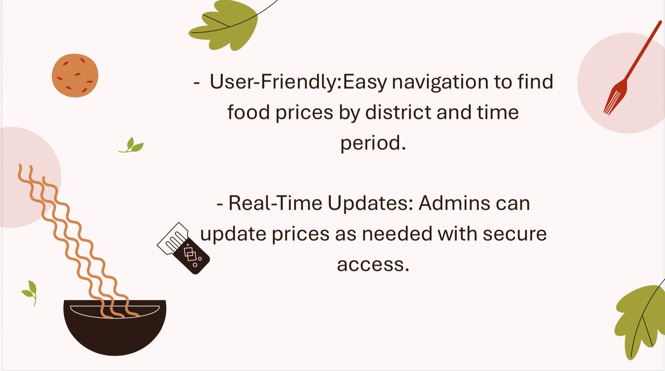
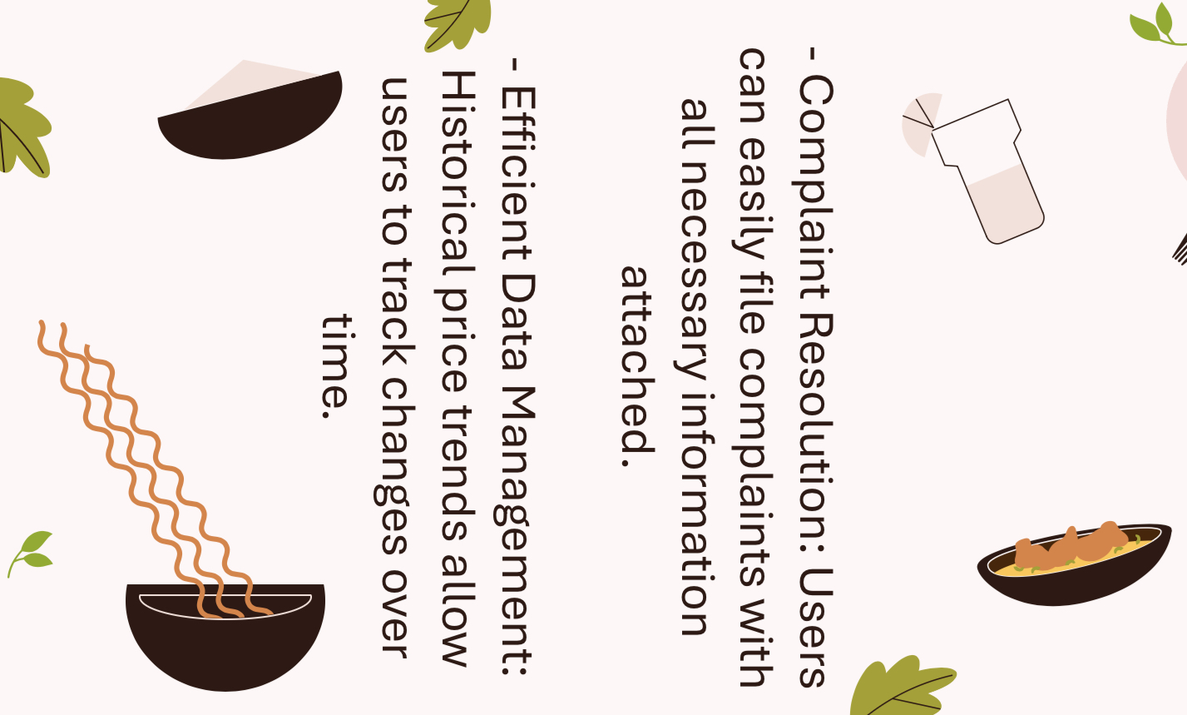
Benefits

Slide 13
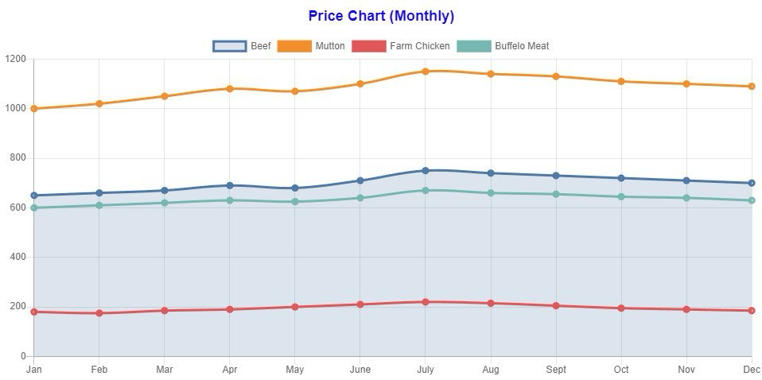
Uniqueness
District-Specific Food Prices:
No other software offers real-time price updates for each district.
01
Comprehensive Complaint System: Ability to link complaints to specific food items and districts.
02
Real-Time Trends:
Detailed price fluctuations over weekly, monthly, and yearly periods, which is rarely available in other platforms.
03

Slide 14
References
Website name:
FOOD SECURITY PORTAL
Link:
https://www.foodsecurityportal.org/tools/food-price-monitor

Slide 15
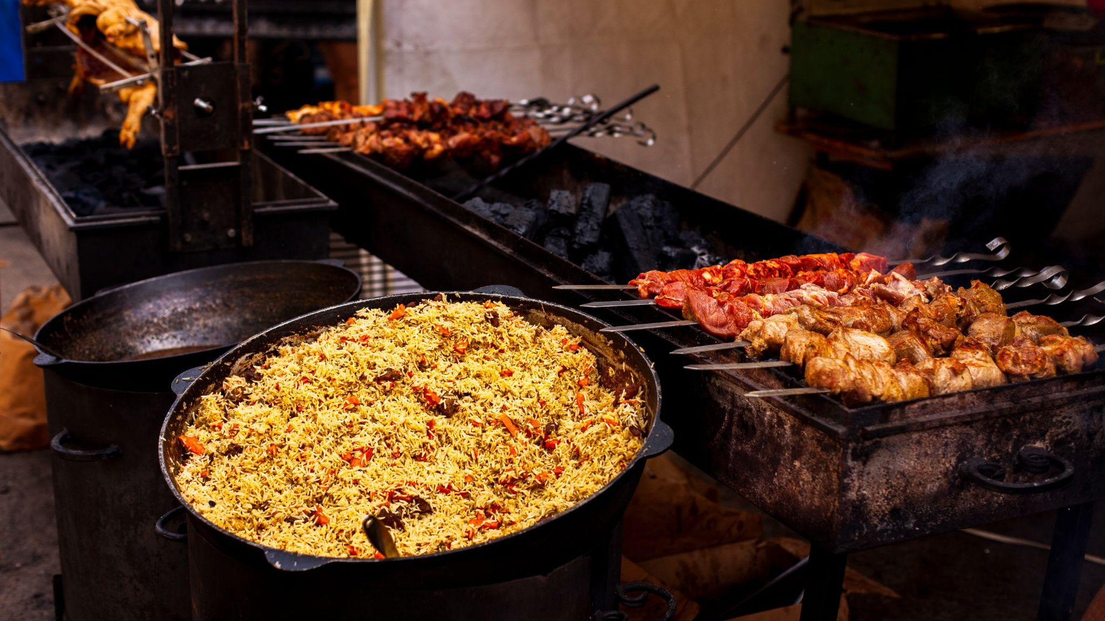
THANK YOU

